Slide 1
BOOTCAMP
ACE ENGINEERING COLLEGE
TOPIC : DATA INTELLIGENCE AND AI

Slide 2
Day 4: Statistical Distribution Analytics with Seaborn Charts
1. Introduction to Seaborn
What is Seaborn?
Seaborn is a Python data visualization library built on top of Matplotlib. It provides a high-level interface for creating attractive and informative statistical graphics with less code.
Why Use Seaborn?
Beautiful default themes and styles
Simplified syntax for statistical visualizations
Easy integration with Pandas DataFrames
Built-in support for complex statistical plots
Better visualization of distributions and relationships

Slide 3
Installation
pip install seaborn
Importing Libraries
import pandas as pd
import numpy as np
import matplotlib.pyplot as plt
import seaborn as sns
# Set plot style
sns.set_style("whitegrid")

Slide 4
2. Density Distributions (Histograms)
What is a Histogram?
A histogram divides numerical data into intervals called bins and shows how many observations fall into each bin.
Purpose
Understand data distribution
Detect skewness
Identify clusters
Spot gaps in data

Slide 5
Data.csv
Age | Salary | Experience
25 | 30000 | 2
30 | 45000 | 5
35 | 60000 | 8
40 | 70000 | 12
45 | 90000 | 15
50 | 100000 | 18

Slide 6
Example Dataset
import pandas as pd
import seaborn as sns
import matplotlib.pyplot as plt
df = pd.read_csv("data.csv")
Histogram Using Seaborn
sns.histplot(df['Salary'], bins=10)
plt.title("Salary Distribution")
plt.xlabel("Salary")
plt.ylabel("Frequency")
plt.show()

Slide 7
Histogram with KDE Curve
KDE (Kernel Density Estimation) provides a smooth density curve.
sns.histplot(df['Salary'],
bins=10,
kde=True)
plt.show()

Slide 8
3. Outlier Detection Using Box Plots
What is a Box Plot?
A box plot summarizes a dataset using:
Minimum value
First Quartile (Q1)
Median (Q2)
Third Quartile (Q3)
Maximum value
Outliers
Why Use Box Plots?
Detect unusual values
Compare distributions
Understand spread

Slide 9
Creating a Box Plot
sns.boxplot(x=df['Salary'])
plt.title("Salary Box Plot")
plt.show()

Slide 10
Box plot observation 200 value
salary = [30,35,40,45,50,55,60,65,70,200]
sns.boxplot(x=salary)plt.show()

Slide 11
Calculating Correlation Matrix
corr_matrix = df.corr(numeric_only=True)
print(corr_matrix)

Slide 12
Creating a Heatmap
plt.figure(figsize=(8,6))
sns.heatmap(corr_matrix,
annot=True,
cmap='coolwarm',
fmt='.2f')
plt.title("Correlation Heatmap")
plt.show()

Slide 13
Heatmap Interpretation
Color Meaning:
🔴 Dark Red → Strong Positive Correlation
⚪ White → Neutral
🔵 Dark Blue → Strong Negative Correlation

Slide 14
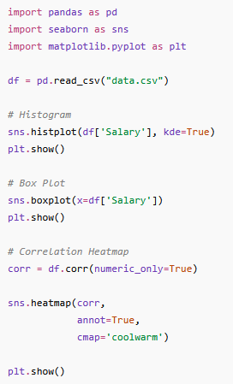
Complete Code

